Slide 1
CSIT511 Group Presentation iPhone Remote
DING Ye, ZHANG Xiaobin, LIAO Qing

Slide 2
Contents
Introduction
Design
Conclusion
iPhone Remote is a powerful and convenient tool for your presentation instead of laser pen.

Slide 3
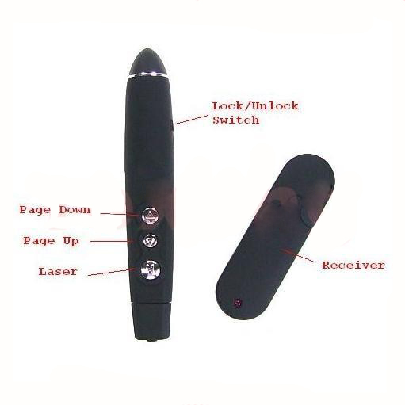
Introduction
Presentation Laser Pen
For Powerpoint use only
Require a receiver
Not extendable
Have to bring it to class
Have to buy it somewhere
Too small laser point
NOT SO GOOD

Slide 4
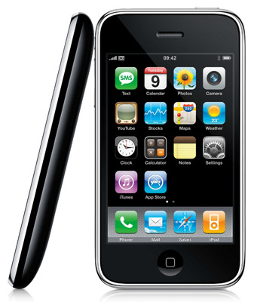
Introduction
iPhone Remote
Compatible in any software
Not require a receiver
Extendable
Just bring your iPhone
Buy it on App Store
Customized laser point
Use iPhone as a mouse
Remote control
Infinity distance

Slide 5
Contents
Introduction
Design
Conclusion
iPhone Remote is a powerful and convenient tool for your presentation instead of laser pen.

Slide 6
Design in Details
DEMO

Slide 7
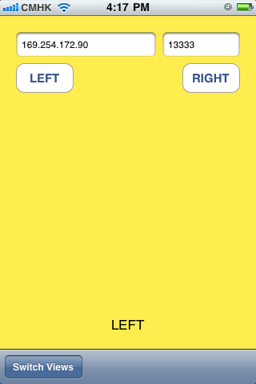
Design in Details

Slide 8
Design in Details

Slide 9
Design in Details
Object C
Xcode 4.1
Mac OS 10.6
iPhone App
Capture tap / slide events
C#
Visual Studio 2010
Windows 7
Connection
Send events to computer
Cooperate work for group members
Computer App
Perform moving / clicking

Slide 10
iPhone App
UI Components
IP address / port number
Host computer
Left / right button
As mouse button
Touch area
As movement
Status label
Display control status

Slide 11

iPhone App
Event 1: Touched
Send position of touching to host computer

Slide 12
iPhone App
Event 2: Moved
Send current point to host computer during moving
Frequency controlled by iOS

Slide 13
iPhone App
Event 3:
Button Pressed
Send button ID to host computer

Slide 14
Design in Details
iPhone App
Capture tap / slide events
Connection
Send events to computer
Cooperate work for group members
Computer App
Perform moving / clicking

Slide 15


Connection
How to send
Using WLAN
Via standard Unix TCP socket
Why WLAN?
Fast and stable than Bluetooth
Compatible with all devices
Long-distance remote control
Send event message
Host
Computer
iPhone
What to send
Event messages in string format
Timestamp (automatically)

Slide 16
Design in Details
iPhone App
Capture tap / slide events
Connection
Send events to computer
Cooperate work for group members
Computer App
Perform moving / clicking

Slide 17
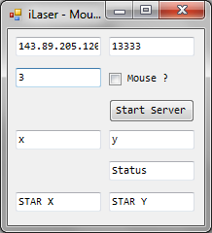
Computer App
Port Number
Used for TCP connection
IP Address of your computer
Used for TCP connection
Scale
Represent moving speed
Mode
Mouse Mode
Laser Pen Mode
Start server button
Press to start this host computer
Debugging Information
Position of point / mouse
Status of point / mouse
Position when start moving

Slide 18

Computer App
Record touching position.
Touched
Perform position mapping, and move mouse / laser icon to correct location.
Perform clicking on mouse location.
Using User32.dll
Receive Events
Button
Pressed
Moved

Slide 19


Computer App
(icx,icy)
(hcx,hcy)
(ix,iy)
$$hcx=\left(icx−ix\right)∙scale+hx$$
$$hcy=\left(icy−iy\right)∙scale+hy$$
(hx,hy)

Slide 20
Computer App
Monitor
iPhone

Slide 21
Contents
Introduction
Design
Conclusion
iPhone Remote is a powerful and convenient tool for your presentation instead of laser pen.

Slide 22
Future Work
Wee!
Shake your iPhone as a mouse.
Developing by Logitech and other institutes.
Keyboard
Add keyboard mapping / simulating.
Same routine as mouse.
Cross-platform
A Linux edition is developing.
Only API problems.
Macro Commands
An interpreter is already made previously.
Make our app much more extendable.

Slide 23
Future Work
Macro Commands
Press
Right
Button
Press
‘O’
Press
‘H’
Immediately start highlighter in Powerpoint.
Edit in iPhone, work in computer.

Slide 24
Thank You!
ANY QUESTIONS?

